Slide 1
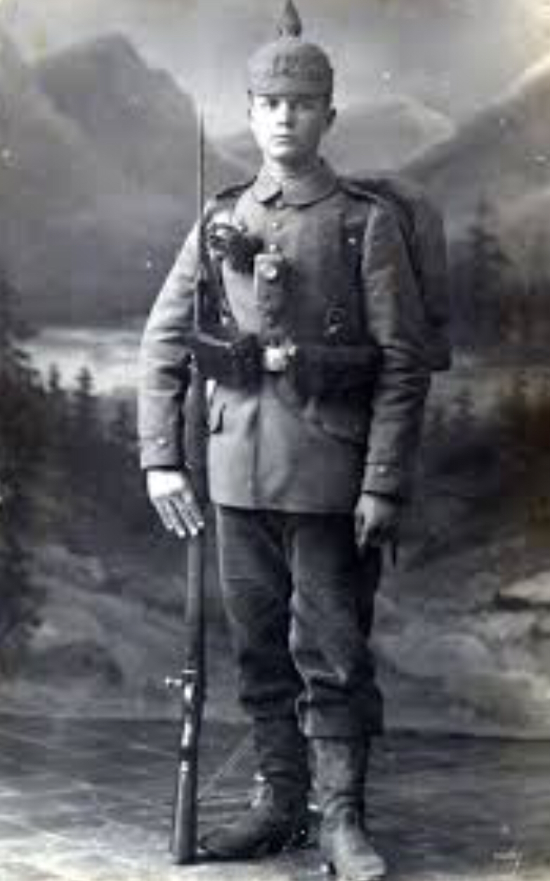
World War I
By: Nuha Mohammed and Krisi Hristova

Slide 2
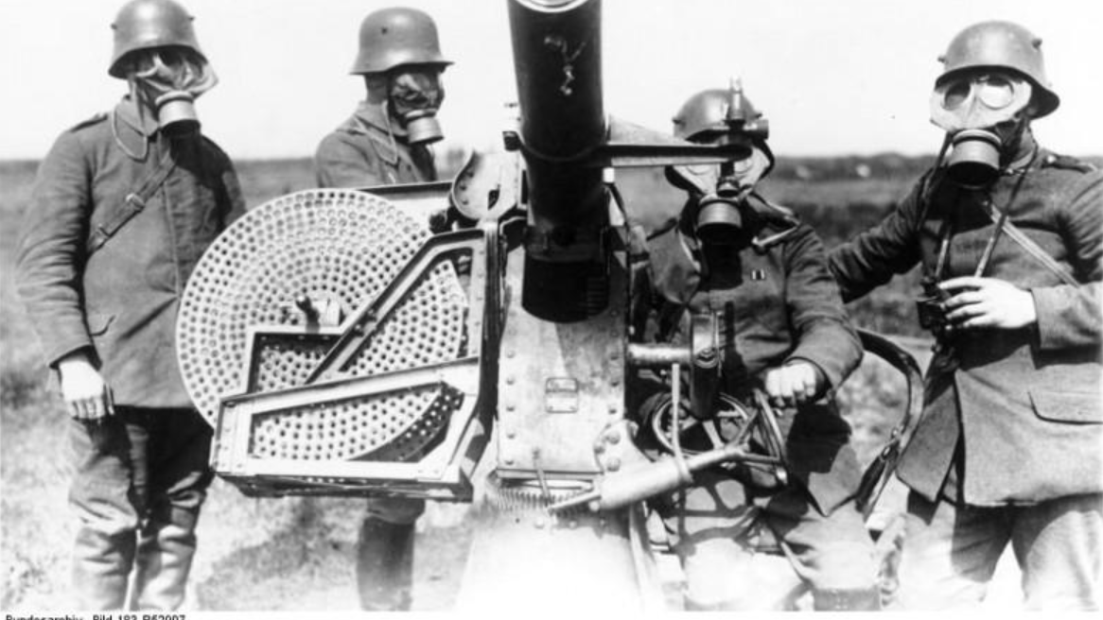
Outline
Tensions Before the War
Alliances Triggered
During & After the War
Important German Leaders

Slide 3
Tensions Before the war
1871-Prussia had united Germany and proclaimed the birth of the German Empire
Prussians had attacked and defeated France
Triple Alliance-Germany, Austria-Hungary, and Italy
Triple Entente-Britain, France, and Russia
Serbs believed their nation’s mission was to unite the South Slavs
Austria-Hungary annexed Bosnia
Franz Ferdinand assassinated by Gavrilo Princip

Slide 4
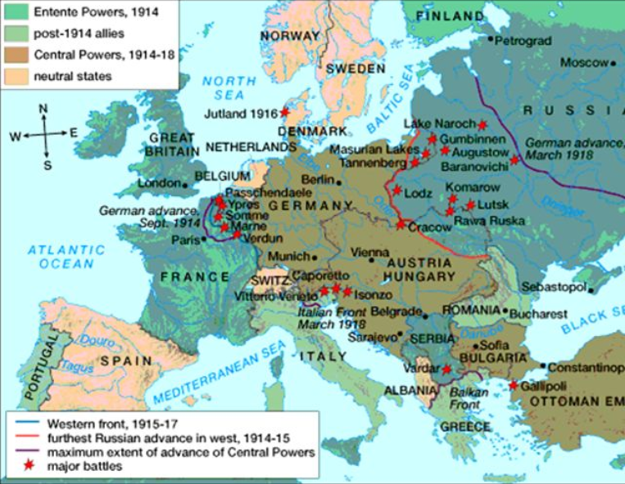
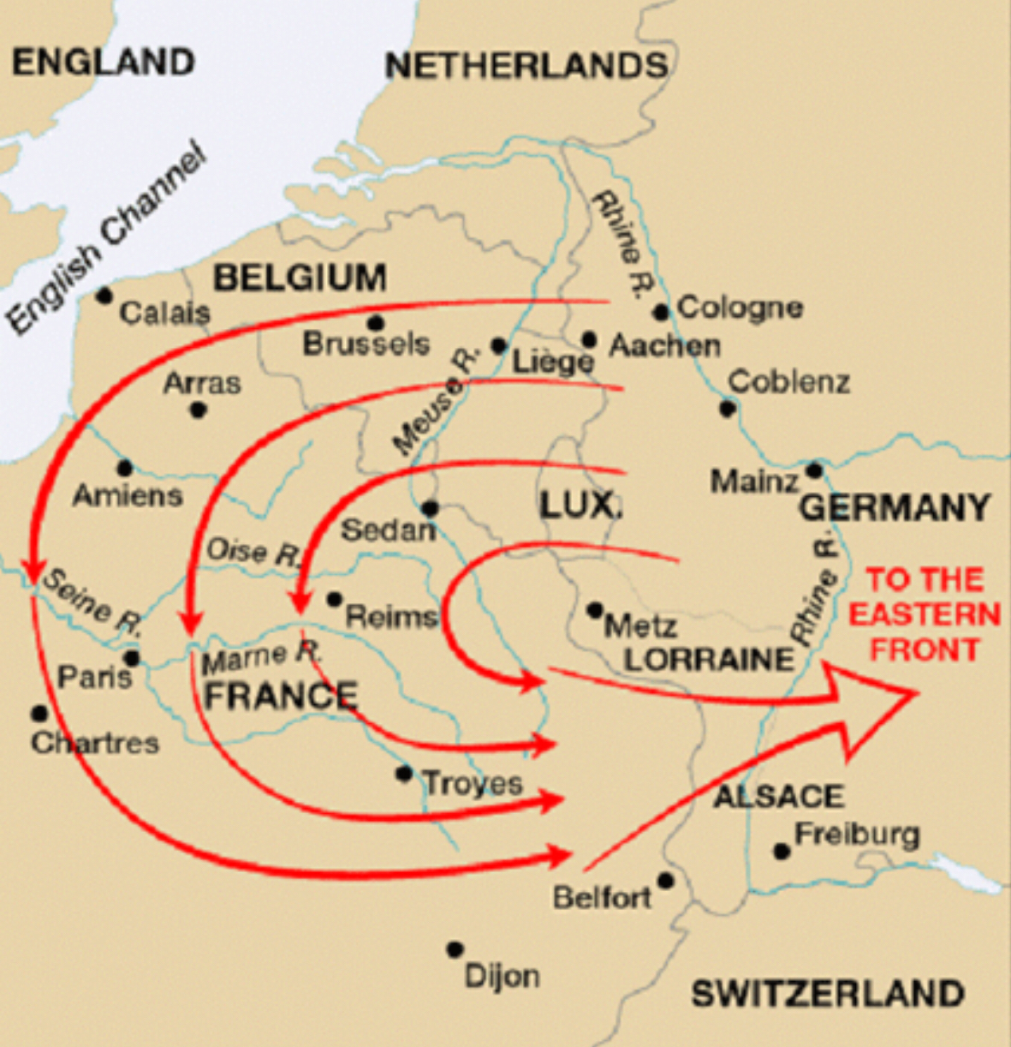
Alliances Triggered & During The War
Germany’s Plan
Move German army through Belgium (neutral)
Attack France (Paris would be surrounded)
Return to defend against Russians
Central Powers-Germany, Austria-Hungary, Ottoman Empire, and Bulgaria
Unrestricted submarine warfare
Zimmerman Telegram
Trench warfare and new technology

Slide 5
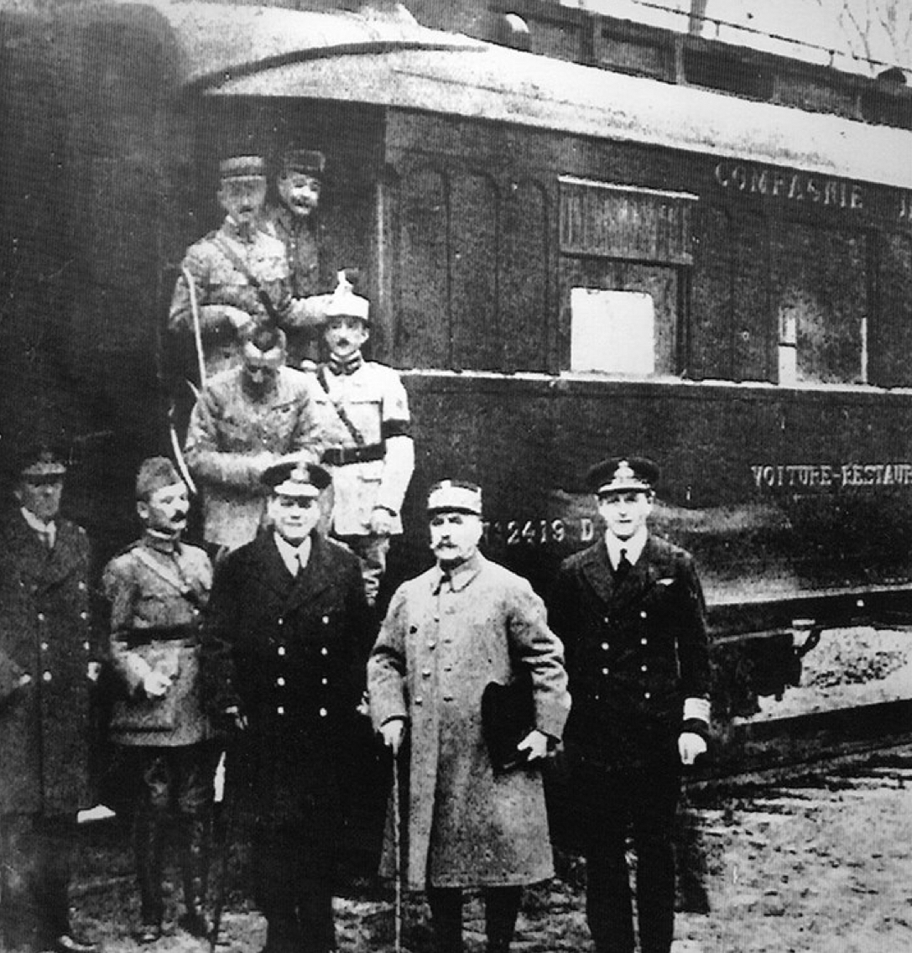
After the War
Germany’s Last Offensive-along western front, reinforcements from Russia
Austria Hungarian Empire and Ottoman Empire dropped out
Treaty of Versailles
Wilson’s Fourteen Points-national self-determination, League of Nations

Slide 6
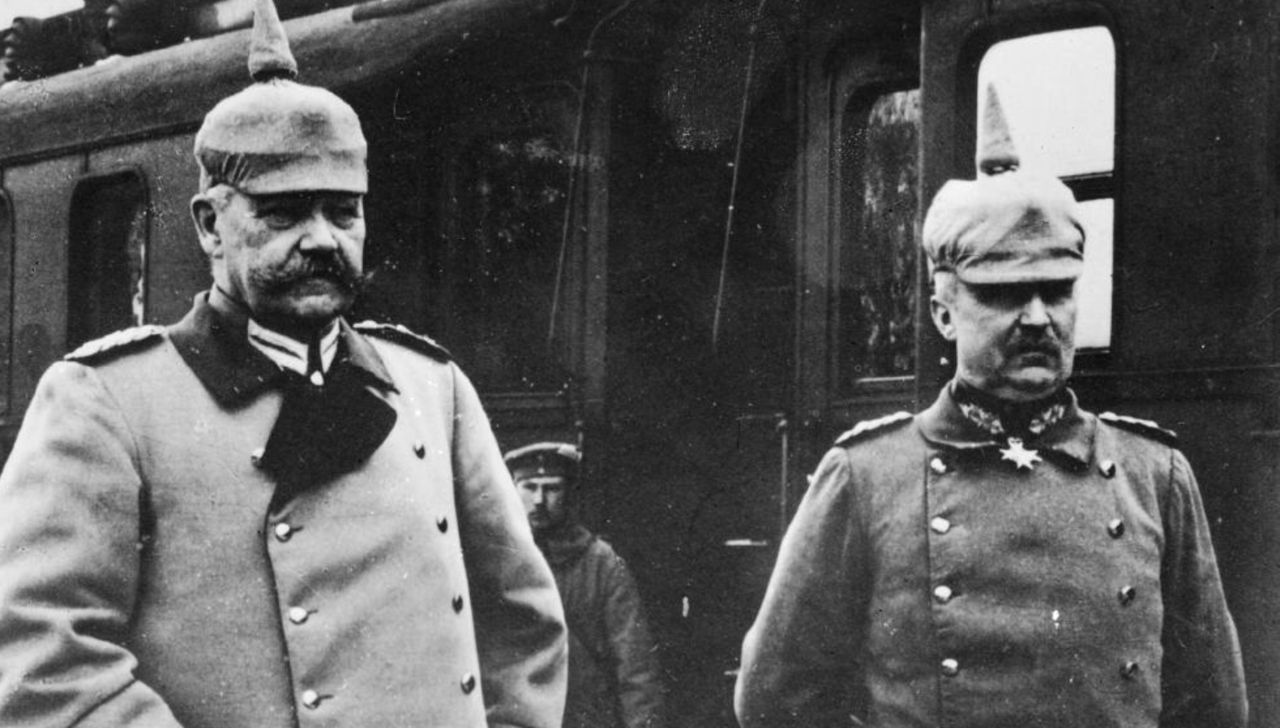
IMPORTANT German Leaders
Kaiser Wilhelm II
Commander in Chief
Didn’t want to go to war
Paul von Hindenburg
New General replaces Kaiser Wilhelm II
Erich Ludendorff
Fights Eastern front
Paul von Hindenburg(left) & Erich Ludendorff (right)

Slide 7
Works Cited
US History Text Book -McGraw-Hill Education. The American Journey. Glencoe/McGraw Hill, 2003.
https://www.britannica.com/place/Germany/World-War-I
https://www.history.com/topics/world-war-i/kaiser-wilhelm-ii
https://www.britannica.com/biography/Erich-Ludendorff

